Slide 1
City of Bloomington, IN
Fire Department
State of Public Safety 2016

Slide 2
Mission
The City of Bloomington Fire Department exists to provide excellent public safety to everyone who lives in, works in, or visits the City; through superb fire prevention, public education, and emergency management / mitigation completed by credentialed and trusted officials who receive first-rate training and high quality equipment.

Slide 3
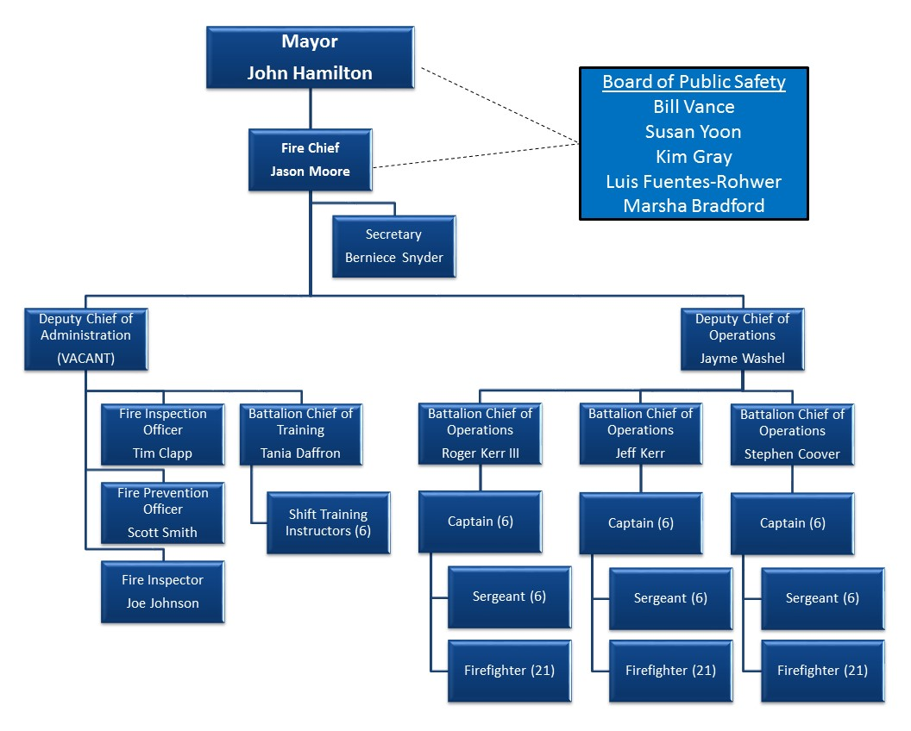
Fire Department – Personnel
Prevention 3 full time employees
Training 1 full time employee
Operations 102 full time employees (34 per shift, 3 shifts)
Administration 4 full time employees
110 Full Time Employees

Slide 4
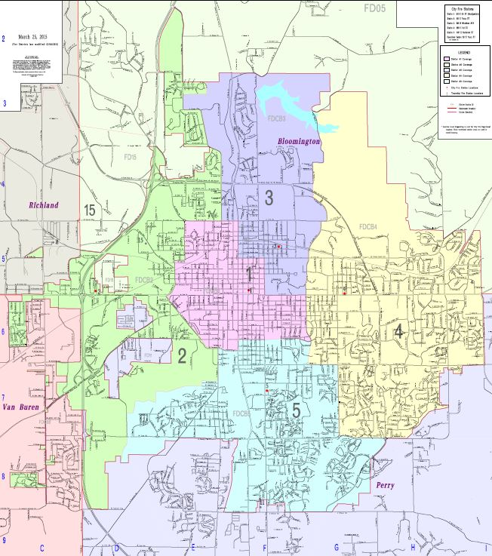
Fire Department – Stations and Apparatus
Station 1 (HQ) - 300 East 4th Street
Rescue Engine, 100 Ft Aerial, Command SUV
Station 2 – 209 South Fairfield Drive
75 Ft Quint (Aerial/Engine), Medium Rescue
Station 3 – 900 North Woodlawn Avenue
Engine
Station 4 – 2201 East 3rd Street
Engine, Medium Rescue, Brush Truck
Station 5 – 1987 South Henderson Street
Engine
We also maintain two reserve Engines

Slide 5
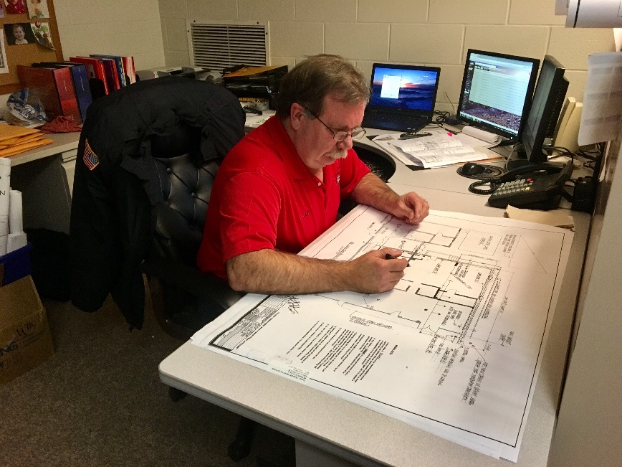
Fire Department – Prevention
There are three E’s that serve as the foundation for a prevention division.
Education – 18,590 Community contacts ranging from station tours to community CPR training
Enforcement – 954 Fire inspections and 47 fire investigations
Engineering – 427 Plan reviews, consultations, and Knox Box reviews

Slide 6
Fire Department – Training
Total Hours for 2016 – 23,946
Reoccuring – necessary to maintain skills and knowledge (15,084 hrs)
New Certification – upgrading or adding to capabilities (2,014 hrs)
Physical Fitness – maintains readiness and employee health (3,911 hrs)
Other/Specialty – ie: protocols, safe place, etc. (2,937 hrs)
GOAL

Slide 7
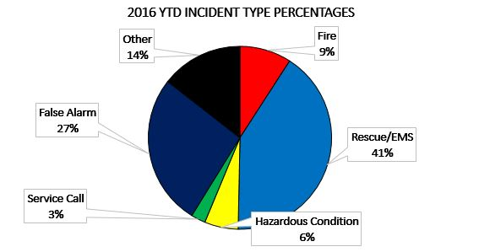
Fire Department – Operations (call types)
Rescue/EMS 1,603
False Alarm 1,041
Other 562
Fire 355
Hazardous Condition 231
Service Call 99
---------------------------------------------
Total Calls in 2016 3,891

Slide 8
Fire Department Operations (Fire Deaths)
88% did NOT have a functional smoke detector.

Slide 9
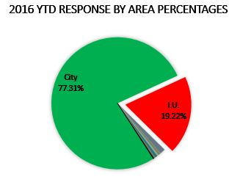
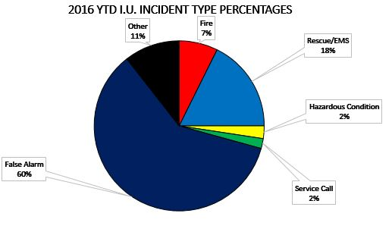
Fire Department – Operations (IU Breakdown)
Calls in City (not IU) 3,008
Calls to IU in 2016 748
Calls to Townships 135
Indiana University Statistics
False Alarm 450
Rescue/EMS 132
Other 79
Fire 55
Hazardous Condition 18
Service Call 14
% of Total BFD calls at IU by type
False Alarm 43%
Rescue/EMS 8%
Other 14%
Fire 15%
Hazardous Condition 8%
Service Call 14%

Slide 10
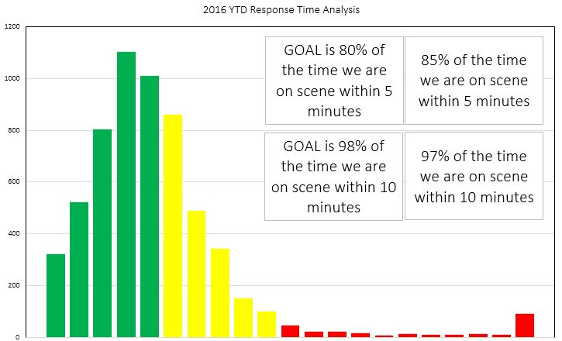
Fire Department – Operations (Response Times)
Issues Affecting Response Times in 2016
Inaccurate reporting by crews
Major construction activities
No response goals until May 2016
Major efforts to correct reporting errors have led to us reaching our response goals in October of 2016.
77% of the time we are on scene within 5 minutes
95% of the time we are on scene within 10 minutes
0-5 minutes
6-10 minutes
11-20+ minutes

Slide 11
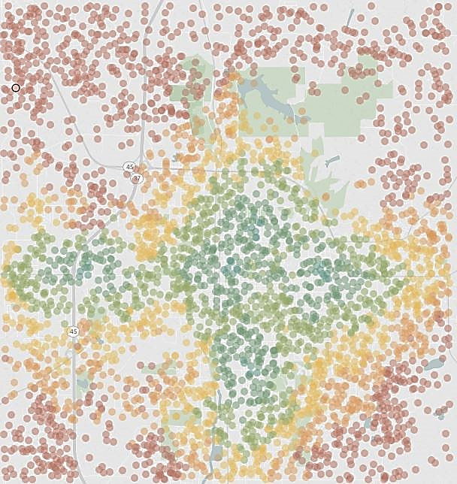
Fire Department – Operations (Resource Planning)
Estimated Response Time Mapping
Collaborative project between BFD and IU Informatics
New tool for determining station placement
Blue and green = 1-2 mins (Excellent)
Yellow and orange = 3-5 mins (Good)
Red ≥ 6 mins (Average)

Slide 12
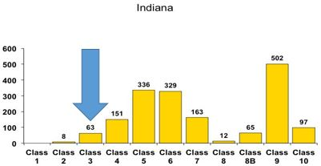
Fire Department – Operations (ISO Rating)
City of Bloomington has an
Insurance Services Office
Rating of 3/3x
Top 8% of rated departments in the US
Top 4% of rated departments in Indiana
Best rated department in Monroe County

Slide 13
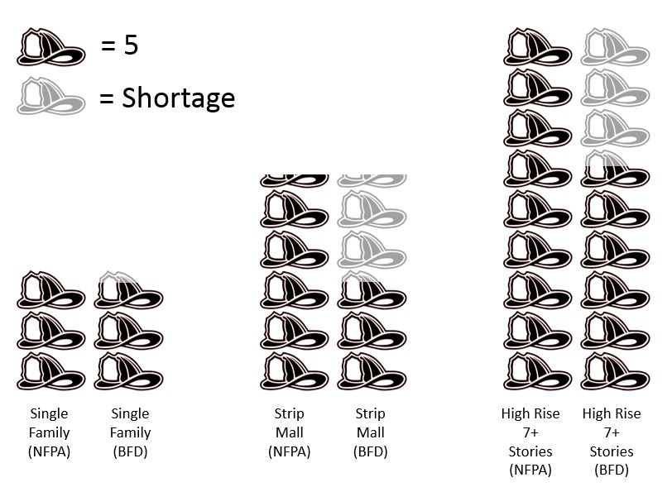
Fire Department – Staffing (NFPA 1710)
NFPA recommends:
Single Family House Fire 15 FF’s
Commercial Fire 28 FF’s
Building 7+ Stories (Fire) 43+FF’s
Single Family
Commercial
7+ Stories

Slide 14
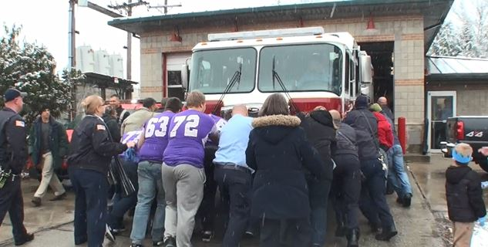
Fire Department – Administration
Annual operating budget for 2016: $9,996,236
Major effort from City / Fire Administration to complete capital replacements
2015 Reversion Funds purchased: New Fire Engine and SUV
Developed a replacement plan to correct equipment / apparatus deficiencies
Pursued Local Income Tax to help with capital needs

Slide 15
Fire Department –2016 Projects / Issues
2017-2020 Fire Union Contract Passed
Identified an issue with overtime pay: back paid employees $235,137
Decommissioned several unsafe apparatus, purchased a new apparatus
Identified 167 minor OSHA violations within the stations, corrected 72, and budgeted for the rest in 2017-2018
Identified and corrected data entry / collection errors
Applied for FEMA grant ($800k) to replace 75 Ft Aerial

Slide 16
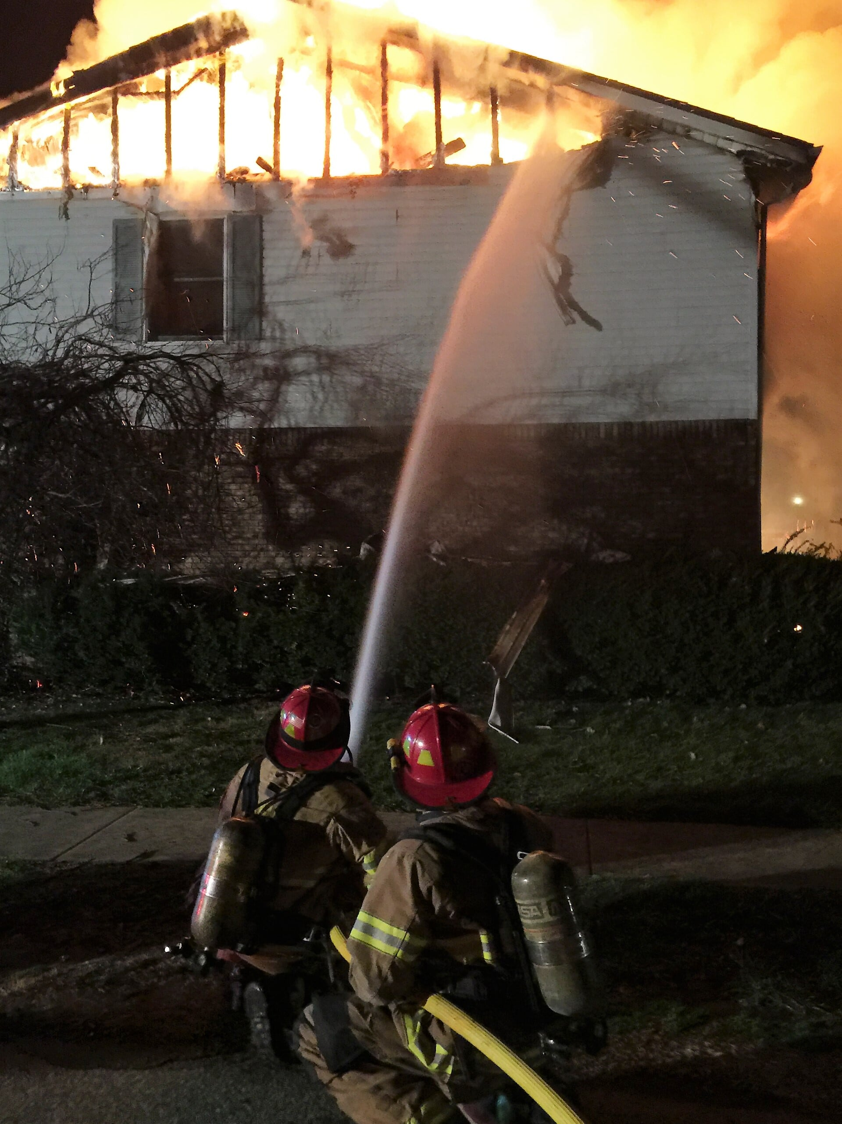
Fire Department – 2017 Goals
Meet response and training goals previously outlined
Ensure the department has at least one prevention contact with every commercial occupancy every year
Continue to replace outdated equipment and apparatus
Conduct a Comprehensive Community Risk Reduction Assessment
Institute a Quartermaster System for firefighting personal protective equipment
Complete a self-assessment to identify accreditation potential

Slide 17
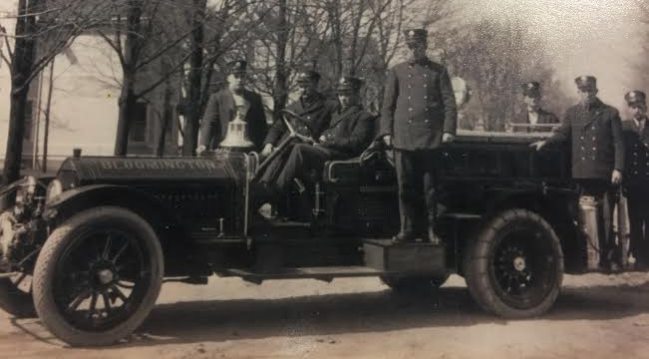
Fire Department – Conclusion
The City of Bloomington Fire Department has been serving and protecting the citizens/visitors of Bloomington and Indiana University for more than 116 years.

Slide 18
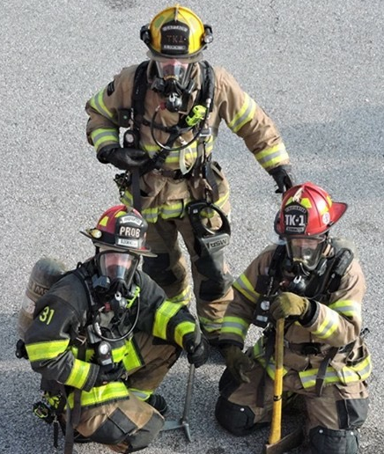
Fire Department – Conclusion
We are the best staffed and trained within Monroe County; able to handle most emergencies that our community will face with minimal assistance from outside entities.
We are Proud of our Firefighters and the important job they complete 24/7/365.

